Slide 1

Team Cyclops (0)
Requirements Milestone Presentation
Eric Jiang
Sumeet Bajwa
Megan Nguyen
Larry gu

Slide 2
Introduction to the Project
Cyclops is currently an information-based website that discusses and informs users of the different issues surrounding the current environmental crisis and the impact the crisis is having on earth.
What we will be doing is creating an educational app for Android and IOS systems by using and transitioning the existing content from the Cyclops website to the mentioned educational app.
The cyclops application will contain many features such as an Eco tracker which contains the users score that they have accumulated after doing eco friendly takes, surveys, and the ability to send feedback comments.
This application and the many features that are going to be implemented will be designed so they can give users a way to not only reduce their own environmental footprint but help with the overall crisis that is occurring.

Slide 3
User Groups
The cyclops application will look to target users that are in school settings, this would include teachers and students. And the next user group would be anyone from the general population, this is anyone with the ability to download the cyclops application and help with the environmental crisis.
The general population user group would be the ones using many of the Functional requirements, these users would be the ones performing daily tasks to track their scores using the in-application Eco tracker feature.
The schooling user group would be the main users using the non-functional requirements, this application when use by schools can be used as a teaching/studying tool. Teachers could use cyclops to teach and inform the students about the environmental crisis that is occurring and what they can do to help. If not being taught, students themselves could use Cyclops as a tool to inform themselves of the issues that are occurring with the environment in the world today.
The third user group for cyclops would be the editors/administrators for the article contents, this user group would be responsible for editing and updating the existing article material on the application.

Slide 4


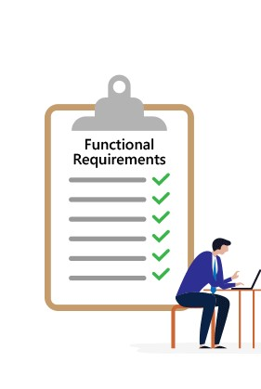
Functional Requirements

Slide 5
Peer Testing #1
These features below should all be finished before they end of Term 1
Search through all the information present on the application
User input scale, when they have done something well to help with environment
Navigate through all the existing information that is transferred over from the website
Eco tracker, this showcases the user’s overall score after using the input scale

Slide 6
Peer Testing #2
Features are going to be finished and implemented by April
Survey section on application
Users have ability to send feedback about content
Users have ability to import/export data

Slide 7
Final Product
Final Product will be delivered in April
Functional requirements from peer testing #1
Functional requirements from peer testing #2
Any new features we decided to include while we continue working on the application

Slide 8
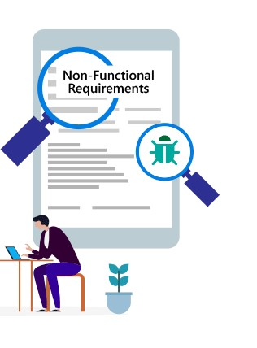
Non-Functional Requirements
Showing user their stats, solutions weighted, and a score given
Notification when content is updated in the application
Synchronize text throughout the apps
Text on application is nice
Text pop up
Survey results send back to Cyclops
Send feedback to Cyclops
Application functionalities implement onto the website

Slide 9
Non Functional requirements – environmental constraints
Ionic is a new building tool being used
Angular framework is being used for the first time
Watching tutorials, looking at documents as we work on creating the application
For Angular
For Ionic
Group members are working from different time zones
Larry, Eric are +13 hours ahead
Must properly manage deadlines to make sure everything is delivered on time
Project is being done during the school year
Group members are taking other classes while managing and working on the project
Other assignments/midterms that need focus outside of the project

Slide 10

Data flow diagrams

Slide 11

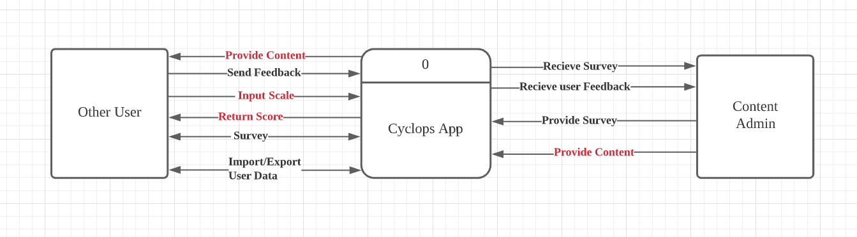
DFD – level 0
This is a simple overview of the features that will be in the App throughout its development. The red part will be due in Peer Testing #1, rest of the part will be due in Peer Testing #2. Generally, the content is provided by Content Admin, and it will be displayed in the App.
Users can review the content. Besides that, they can submit their feedback to the admin, and the admin will receive their feedback. Also, the user can create scales and receive scores.
Moreover, Admin will provide some surveys to users, the user will complete the survey through the APP, and after the submitting of Survey, the admin will see the results. Lastly, the user can import/export their data when they change their devices.

Slide 12
DFD – level 1
Level 1 shows more specific processes. The admin user has the ability to edit/post the content, it is stored in the database. The app displays the content by the “display content” process. It receives content from the database and displays with some additional features i.e. searching, pop-up keywords.
The user can submit the feedback based on the content by the “create a feedback” process. Then the feedback is stored in the database, and the admin user will see feedback by the “display feedback” process.
The user can create scales by the “create scale” process, then scales are stored in the database. The “calculate score” process gets the user’s scale from the database and returns a score to the “display score” process.
The content admin can create surveys for the user, the survey will be stored in the database after the “edit/add survey” process. After the user completes a survey, the “create survey report” process receives the user's answer, and it will be stored in the database. The “display survey report” process gets the report from the database, and displays it to the content admin.
The user can export or import their personal data. The “process user data” process receives user’s data and stores it in the database. It also gets user’s data from database, and updates data to the user.

Slide 13
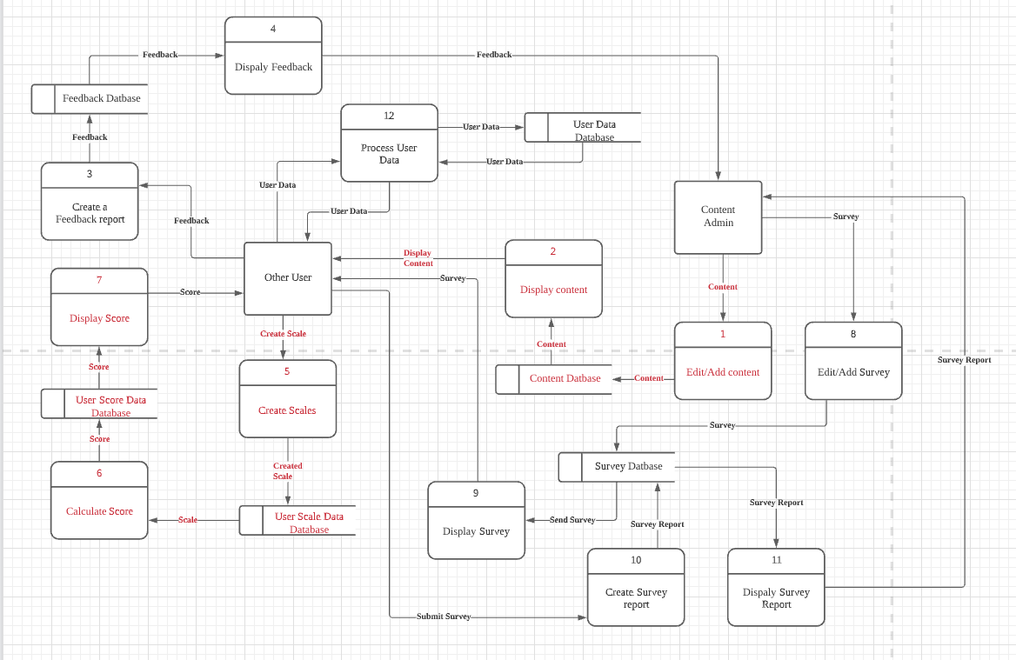
Dfd – level 1 diagram

Slide 14



TECH STACK OPTIONS

Slide 15
Unity + Flutter + Ionic
Pros
All three of them are cross platform
Only need one code base for all platforms
All of them wouldn’t cost any money to use

Slide 16
Unity
Cons
Unity is not conventionally used for a web-app
Won’t have any ready to use UI Modules
Higher cost to implement the website if Unity is chosen
Pros
Powerful tool for rendering effects
Can build animations from scratch with the various libraries Unity provides
Learning curve is not as steep compared to those in the JavaScript Frameworks
C# will be language used
C# has concepts and structures similar to Java
Language transition will be much easier for us

Slide 17
Flutter
Pros
Among the three, Flutter provides the best-looking gadgets off the shelf.
Cons
Though Flutter are designed to for companies to develop a web-app, it is still relatively young
It is using the language called Dart, which none of our group members have experience using it.
The community is much smaller compared to the others.

Slide 18
ionic
Cons
For all rendering of animations, need to be proficient in JavaScript and at least one framework
Choose from Angular ,React, or Vue
All have steep learning curves
Pros
Powerful tool for developing all platform web-apps
UI Modules: Have access to many built-in tools to implements functions that normal wouldn’t show up in a conventional app
Transitioning from app into website is easier

Slide 19
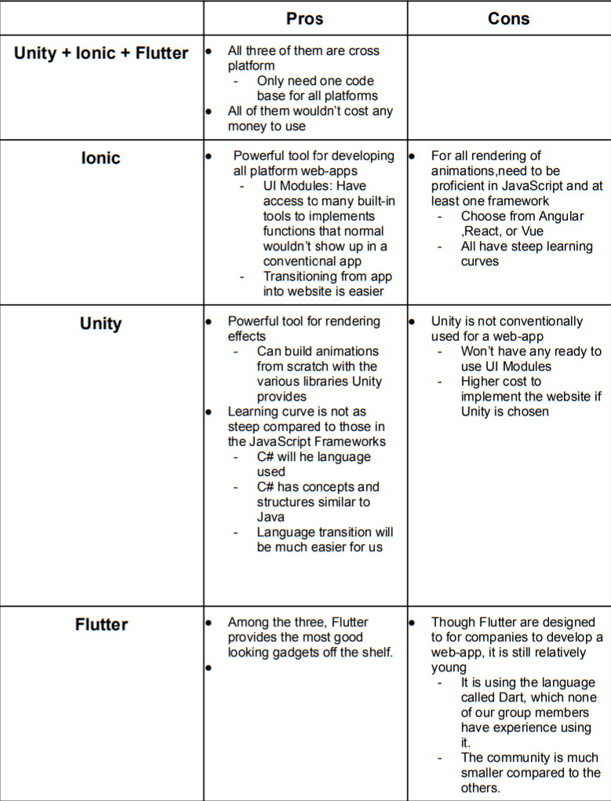

Slide 20
Chosen Tech Stack
Considering all the information that was found below in the table, as a group we decided it would be best to use Ionic as the main building tool to deliver the Cyclops application. We concluded Ionic was the best building tool to use because of the following reason:
It has adaptive styling
Allows the application developers to use the same code base for multiple platforms
With adaptive styling, allows us to create a similar user experience across all the platforms the application will be on.
Ionic contains navigation that can be used in a mobile app
Has Native access
Such as camera or GPS on a user device
Ionic has Theming

Slide 21
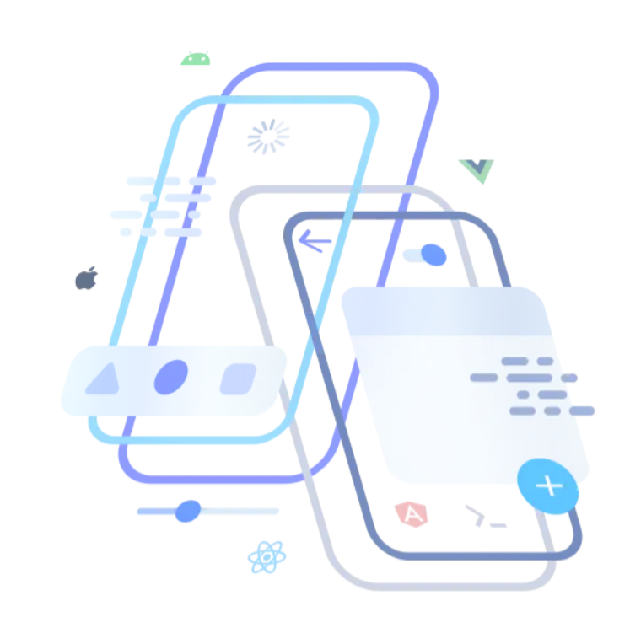

Testing the developed features: Intro & Unit Tests
Ionic provides ready-to-use professional test systems for:
Unit Tests
End-to-end Tests
We will create code isolation for Unit Testing
Dependency injection
Open source mocking tool: Jasmine
Contained under the “spec” folder

Slide 22
Testing the developed features: end-to-end test & acceptance test
We also need End-to-end Testing
Automate common user interactions
Generated in the e2e folder
Examine the DOM(Document Object Model) for validations
Continuous Integration
Involves both Unit Test and End-to-End Test
Maintains code robustness
Acceptance Tests
To better meet the functional and non-functional requirements

Slide 23
Thank You

